Slide 1
Τμήμα Διοίκησης Επιχειρήσεων
ΤΕΙ Κεντρικής Μακεδονίας
MBA in Hospitality and Tourism
Methods of Business Administration and their Application in Tourism Enterprises, The Case Study of Blue Palace, a luxury Collection of Starwood/Marriott Resort & Spa and Kipriotis Hotel Group
Supervisor professor: Giovanis Nikolaos
Developed by: Papathanasiou Vyron
Registration number: 67
Serres, 2018

Slide 2

Part One
Forms of Corporation
Business administration
Management

Slide 3
Corporation is considered to be any economic entity that produces materials, products or services by appropriately combining the production factors to achieve its objectives
According to their ownership
Public corporations
Private corporations
According to their legal form
Individual businesses
Corporate enterprises
(at least two people)
Personal businesses
General partnership
Limited partnership
Open or incorporating company
Capital companies (funds, not the faces)
SA. (Society Anonymous Company
Limited Liability Companies

Slide 4
Management is the process of planning, organizing and control of a business or organization in order to effectively achieve their objectives
Basic functions
Planning
Organizing
Decision making
Managing
Controlling
Rules
Behavioral objectivity
Follow-up the administration
Keeping a hierarchy
Direction module
Unity of staff

Slide 5

Part two
Tourism
Tourism enterprises
Tourist product

Slide 6
As tourism we mean the set of the relationships and phenomena that arise through travel and the residence of individuals in one place of stay. The place of stay for these people is not the main and the permanent place of residence, not their place of work.
UNWTO
The types of businesses involved in the tourism are:
Direct suppliers
Support services
Development organization

Slide 7
Tourist enterprises are distinguished according to their purpose in the following
Types of accommodation
Hotels
Motels
Rental rooms
Apartments
Travel agencies
Domestic tourism
General tourism
Ship brokers
Transport companies
Bus tour operators
Car rental companies
Airline companies
Cruise ships
Food and entertainment venues
Restaurants
Bars
Cafes
Night clubs
Other types of businesses
Souvenir gift shops
Casinos
Healthcare
Etc

Slide 8

Part three
Hotel Businesses
Travel Agencies
Aviation

Slide 9
Hotels can classified according to some of their characteristics
Depending on size:
Small
Medium
Large
Very large
Depending on category
Super luxury
Luxury
Luxury floors
Middle class
Budget hotels
Depending on location
Mountain
Seaside
Urban
Spa
Highways
Depending in operation
Continues operation
Seasonal operation
Depending on the market they are targeting
Commercial hotels
Airport hotels
Apartment hotels
Vacation hotels
Room and breakfast hotels
Timeshare hotels
Casino hotels

Slide 10
Hotel Segmentation
Department of bedrooms and costumer reception
(Operation of the rented rooms as well
as the customer service)
Food and beverage department
(Main responsibilities are the
purchase, manufacture and
distribution of food and beverages to
hotel guests)
Technical service – Maintenance department
(proper maintenance repairs)
Sales department
(Sale and promotion of the hotel
product)
Human resources department
(the attraction, the qualification
process, the selection and placement
of the staff, the recruitment of skilled,
talented and motivated workers)
Financial department
(It deals with the company’s financial
data)

Slide 11
The role of the travel agent is an important factor in the tourism industry because the tourist needs the guidance of an expert and this role can only be played by him who will help him by offering the appropriate advice
Based on legislation
Domestic tourism agencies
General travel agencies
Based on the subject of
the services they offer
Outgoing agencies
Incoming agencies
Incoming and outgoing agencies
Types of travel agencies
Based on size and
Specialization
Tour operator
Travel agents-retailers
Travel agents-correspondents
Based on the size of their
Work
Multinational offices
National offices
Peripherals
Based on the type and
range of services
Tourist and leisure agencies
Holiday agencies
Business travel agencies
Conferences and incentive travel agencies
Specialist offices

Slide 12
Characteristics of airline companies
The product
It is a service, the transfer of
customer from the one point in
Another
Activation sites
Cities where the company’s offices can
be operating, at the airports and in the
Airplane
Vertical integration
it can carry out vertical upsides, upwards
or downwards by creating or buying tourist
businesses and this to offer and benefit
financially from it, a more complete tourist
product to its customers.
Its environment
Travel agencies, global booking,
customers

Slide 13

Part Four
Blue palace, a Luxury Collection Resort & Spa

Slide 14
Blue palace, a Luxury Collection Resort & Spa
is one of the 69 Resorts and Hotels o f the Luxury Collection
Under the brand name of Starwood, and after 23rd of septembe,2016, under the brand name of Marriott
Is under the mother company of Sbokos Hotel Group
Is located 3 kilometers away from Elounda, in Laisthi of Crete, Greece, right across the historic island of Spinalonga
251 bungalows, suites and villas
3 outdoor public swimming pools
4 a la cart restaurants
24hr room service
3 bars
Private beach
2 tennis courts
A helipad
Water Sports and diving center
A kid’s club
Spa and luxurious shops
Is operating 6-7 months per year, from April until the end of October

Slide 15
Segmentation of the company
General Manager
Front Office
Reception
Reservations department
Telephone operator
Guest relations
Account receivable specialist
Bell boys
F&B Department
Kitchen
Restaurants
Bars
Supplies
Housekeeping department
Sales department
Information technology (IT)
department
Cost control
Human resources department
Maintenance
Warehouse
Linen closet
Beach
Spa

Slide 16

Part Five
Kipriotis Hotel Group

Slide 17
Kipriotis Hotel Group
Is on of the largest hotel groups in the Dodecanese in Greece
Among the top 20 hotel chains of our country
6000 beds and two conference centers
Three kilometers from the center of Kos, in Psalidi area
Two 5* hotels
(kipriotis Panorama Hotel &
Suites and Kipriotis Maris
Suites)
Three 4* hotels
(Kipriotis Village Resort,
Kipriotis Hippocrates Hotel and
Kipriotis Aqualand Hotel)

Slide 18
Kipriotis Hotel Group
Services
24hr doctor on request (extra charge)
Foreign currency exchange
Car rental
Bike rental
Wi-Fi internet area
Laundry service (extra charge)
Outdoor parking
Mini bus service around the property
Courtesy room
Luggage room
Bellboy service
Late checkout (upon availability, extra charge)
Supermarket
Room facilities
Air condition
Bathroom with hair dryer
Satellite TV/Radio
Fridge
Safe box
direct dial telephone
Tea & coffee facilities
Mineral water on arrival

Slide 19
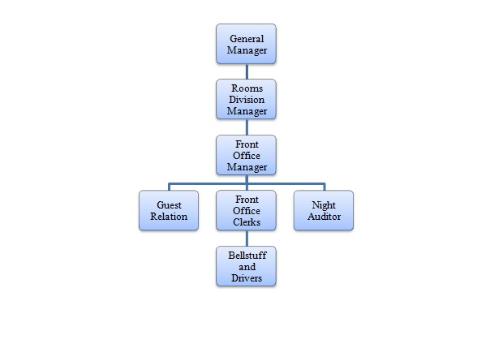
Front office segmentation

Slide 20


